Slide 1
Lab7 Dynamic Arrays & Streams and File I/O
DEE 1319
Department of Electronics Engineering
National Chiao Tung University

Slide 2
Outline
Dynamic memory
Streams & File I/O
Lab7 exercise
Lab7 homework

Slide 3
Dynamic Memory
Sometimes, we can’t know what size of array we need in advance…
void f(){ int score[100]; // the size is FIXED before program execution int num; cout << “ How many students in this class? ”; cin >> num; // what if num > 100?? for(int i = 0; i < num; ++i) cin >> score[i]; // out-of-range runtime error! //… }

Slide 4
Dynamic Memory
In C
Allocate dynamic memory ➔void *malloc(size_t size); //size in byte
Deallocate dynamic memory ➔void free(void *ptr);
In C++ void f(){ int *score; // score is just a pointer int num; cout << “ How many students in this class? ”; cin >> num; score = new int[num]; // allocate a memory block from system to store num integers //i.e., determine the array size at runtime for(int i = 0; i < num; ++i) cin >> score[i]; // score acts like an array! //… delete[ ] score; //deallocate (return) the memory block to system }

Slide 5
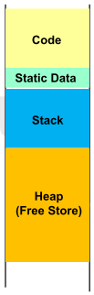
Memory Layout
Code segment
Program execution code
Static date segment
Global objects and static local objects
Stack
Non-static local objects (i.e., automatic objects)
Heap or free sore
Free memory, not used by program at the beginning
Its size is finite and managed by operating system
Dynamic memory management
Ask for extra memory blocks from heap by new operators dynamically (i.e., at runtime)
Return them back to heap by delete operators dynamiclly

Slide 6
new Operators
Allocate dynamic memory from heap
when extra memory is required at run time
get memory from heap
if requesting an object of type X ➔ return value of new operator is of type X*
int *p = new int(5); //*p = 5 initially
… //do something
delete p;
p points to allocated memory

Slide 7
delete Operators
Deallocate dynamic memory
When allocated memory is no longer needed
Return previously allocate memory to heap
Example:
int *p = new int(5); //*p = 5 initially
…//do something …
delete p; // NO return value for delete operator
deallocate allocated memory pointed by p

Slide 8
Operator ->
Member access operator, ->
Member selection from a pointer
class X{
public:
int d1, d2;
void mbr_func(int);
};
void f(){
X x, *px = &x;
x.d1 = 10; //member selection using .
x.mbr_func(3);
}
px->d2 = 20; //equivalent to ➔ (*px).d2 = 20;
px->mbr_func(5); //equivalent to ➔ (*px). mbr_func(5);

Slide 9
Dynamic Arrays
Dynamic array
e.g.,
size can be determined at runtime ➔ flexible
However , dynamic memory allocation is relatively time-consuming
Avoid using dynamic array if size is known at compile time
int *pi=new int[size];

Slide 10
Creating Dynamic Arrays
Use new[] operator ➔ X *pX = new X[sz];
sz can be a variable, determined at runtime
Dynamically allocate enough memory for sz elements of X
Return the start address with type X*
If X is a user-defined type, default ctor of X is invoked for every element in this dynamic array in order
What if there is no default ctor? ➔ new[] is not allowed!
int sz = 10;
double *pd = new double[sz]; //ok, double is a built-in data type
//assume class X has default ctor and class Y doesn't
X* pX = new X[sz]; //ok, call default ctor for pX[0], pX[1], …, pX[sz-1]
Y* pY = new Y[sz]; //error ! No default ctor is available

Slide 11
Destroying Dynamic Arrays
Use delete[] operator ➔ delete[] pX;
no need to put sz in []
need [] to tell compiler that pX points to an array instead of a single object
dynamically deallocated previously-allocated memory
no return value
if X is a user-defined type, dtor of X is invoked for every element in this dynamic array in reverse order
delete[] pd;
delete[] pX; //call dtor for pX[sz-1], pX[sz-2], …,pX[0]

Slide 12
Destructors
class intArr{
int size,*arr;
public:
intArr(int sz) :size(sz) {arr = new int[sz]; } //ctor
~intArr(); //dtor
int& operator[](int idx); //access idx-th element with range checking
};
intArr::~intArr( ){ //NO return type and NO parameters are allowed
delete[] arr; // dellocation here, no memory leak now
}
dtor is automatically invoked right before an object is destroyed
Mainly for clean-up operations

Slide 13
File I/O Libraries
To allow both file input and output in your program: #include <fstream> using namespace std;
OR
#include <fstream> using std::ifstream; using std::ofstream;

Slide 14
File Open and Close
Two ways for file open
Method 1 ifstream ifs(“pathname/input_file_name”); ofstream ofs(“pathname/output_file_name”);
Method 2 ifstream ifs; ifs.open(“pathname/input_file_name”); ofstream ofs; ofs.open(“pathname/output_file_name”);
Close
ifs.close();
ofs.close();

Slide 15
Streams Usage
Once input/output file stream are successfully opened ➔ You can use them just like input/output streams
int i; double d; char str[100]; ifstream ifs(“ifilename”); ifs >> i >> d; ifs.getline(str, 100); //not from keyboard but input file ofstream ofs(“ofilename”); ofs << i << endl <<setprecision(8) << fixed << d; ofs.put(‘\n’); //not to screen but output file

Slide 16
Checking File Open Success
File opens could fail
If input file doesn’t exist
No write permissions to output file
Unexpected results
Use member function fail() or operator !
ifstream ifs(“in.txt”); if (ifs.fail()){ cout << “File open failed.” << endl; exit(1); } ofstream ofs(“out.txt”); if(!ofs){ cout << “Output file open failed.” << endl; exit(1); }

Slide 17
Checking End of File
Use loop to process file until end
Typical approach
Test for end of file
Member function eof()
eof() returns true if end-of-file is reached
char next; ifs.get(next); while (!ifs.eof()){ cout << next; ifs.get(next); }

Slide 18
Lab7 Exercise (1/3)
Create a class named Vector that has three member variable:
begin
A dynamic array of string used to store the input data
capacity
An integer to store the size of the array
size
An integer to store how many data in the array

Slide 19
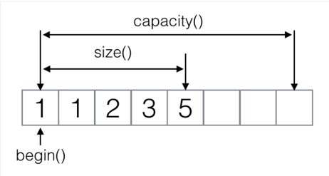
Lab7 Exercise (2/3)
When you put the data into the array, you have to check whether the capacity has been full or not.
If so, you have to increase the capacity of the array
by using the following formula
max(capacity+1, capacity*3)

Slide 20
Lab7 Exercise (3/3)
Write appropriate ctor, dtor, member functions for the class along with the following
push_back(string): put the data into the array
A dtor that releases all memory that has been allocated

Slide 21

Input
Input format
<vector1> ;
<vector2> ;
…
Example:

Slide 22
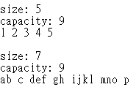
Output
Output format
size: <size of vector> capacity: < capacity of vector > <all data in the vector> …
Example:

Slide 23
Lab7 Homework (1/2)
Create a class named Student that has three member variable:
name
A string that stores the name of the student
numClass
An integer that tracks how many courses the student is currently enrolled in
classList
A dynamic array of strings used to store the names of the classes that the student is enrolled in

Slide 24
Lab7 Homework (2/2)
Write appropriate ctor, dtor, member functions for the class along with the following
A function that outputs the name and list of all courses
A function that inputs all courses which the student is enrolled in
A function that checks whether the student is enrolled in the specific class or not
A dtor that releases all memory that has been allocated

Slide 25
Problem
You need to reads all data of all students from the input file, including the student’s name and the list of classes he/she enrolled in
Given: an input file with student’s information
Output: an output file with class’s information

Slide 26
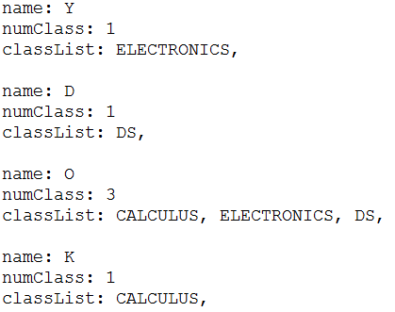
Input
Input format
students: <num> name: <name> numClass: <num> ClassList: <class1>, <class2>, …
Example:
students: 4

Slide 27
Output
Output format
Part 1
Class: <classname1> <all students enrolled in it> Class: <classname2> <all students enrolled in it> …
Part 2
#students: <total_number_of_students> Name # Classes <name1> <num> <class1>, <class2>… <name2> …

Slide 28
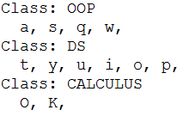
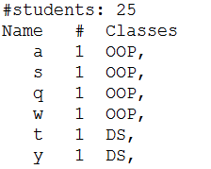
Output Example
Part 1
Part 2

